Slide 1
AUTOMATIC NUMBER PLATE DETECTION SYSTEM
COL867: Supervised by Prof. Rajeev Shorey K Varshitha – 2019CS51065 Akhila Nenavath – 2019CS50417 Sriram Varma – 2019CS50426

Slide 2
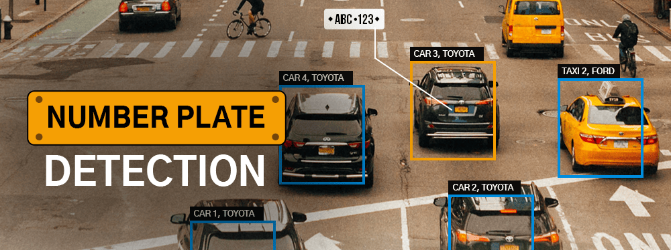
Problem Statement
An Automatic Number Plate Recognition System (ANPR) is a critical component of modern transportation and security infrastructure, providing numerous applications such as traffic management, law enforcement, toll collection, and vehicle access control. The main challenge is to develop an accurate, efficient, and scalable ANPR system capable of recognizing license plates from various types of vehicles in diverse environmental conditions.

Slide 3
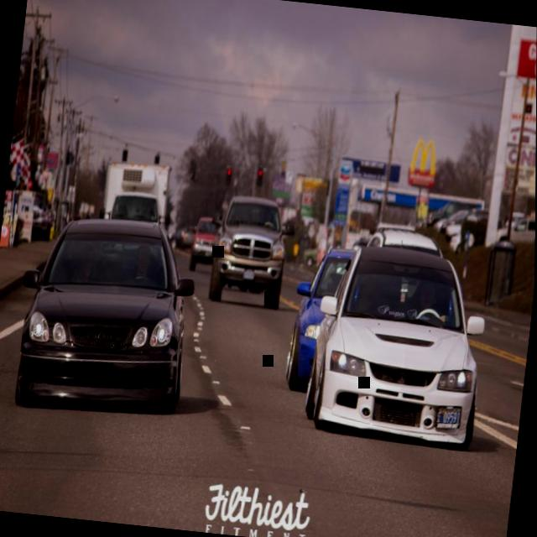
MODEL
Ultralytics is an open-source computer vision framework and a set of related tools for machine learning and deep learning, particularly focused on object detection and image segmentation tasks. We used this to train with our dataset.
DATASETS:
Training dataset size 21,173 items (846.6 MB)
Testing dataset size 1,019 items (46MB)
Valid dataset size 2,406 items (91.5MB)
Each data set item has:
IMAGE LABEL
X1 X2 Y1 Y2
0.46268426883774366 0.50546875 0.022011355386194253 0.0234375
0.8360798204601911 0.78125 0.048682939695149585 0.0421875

Slide 4
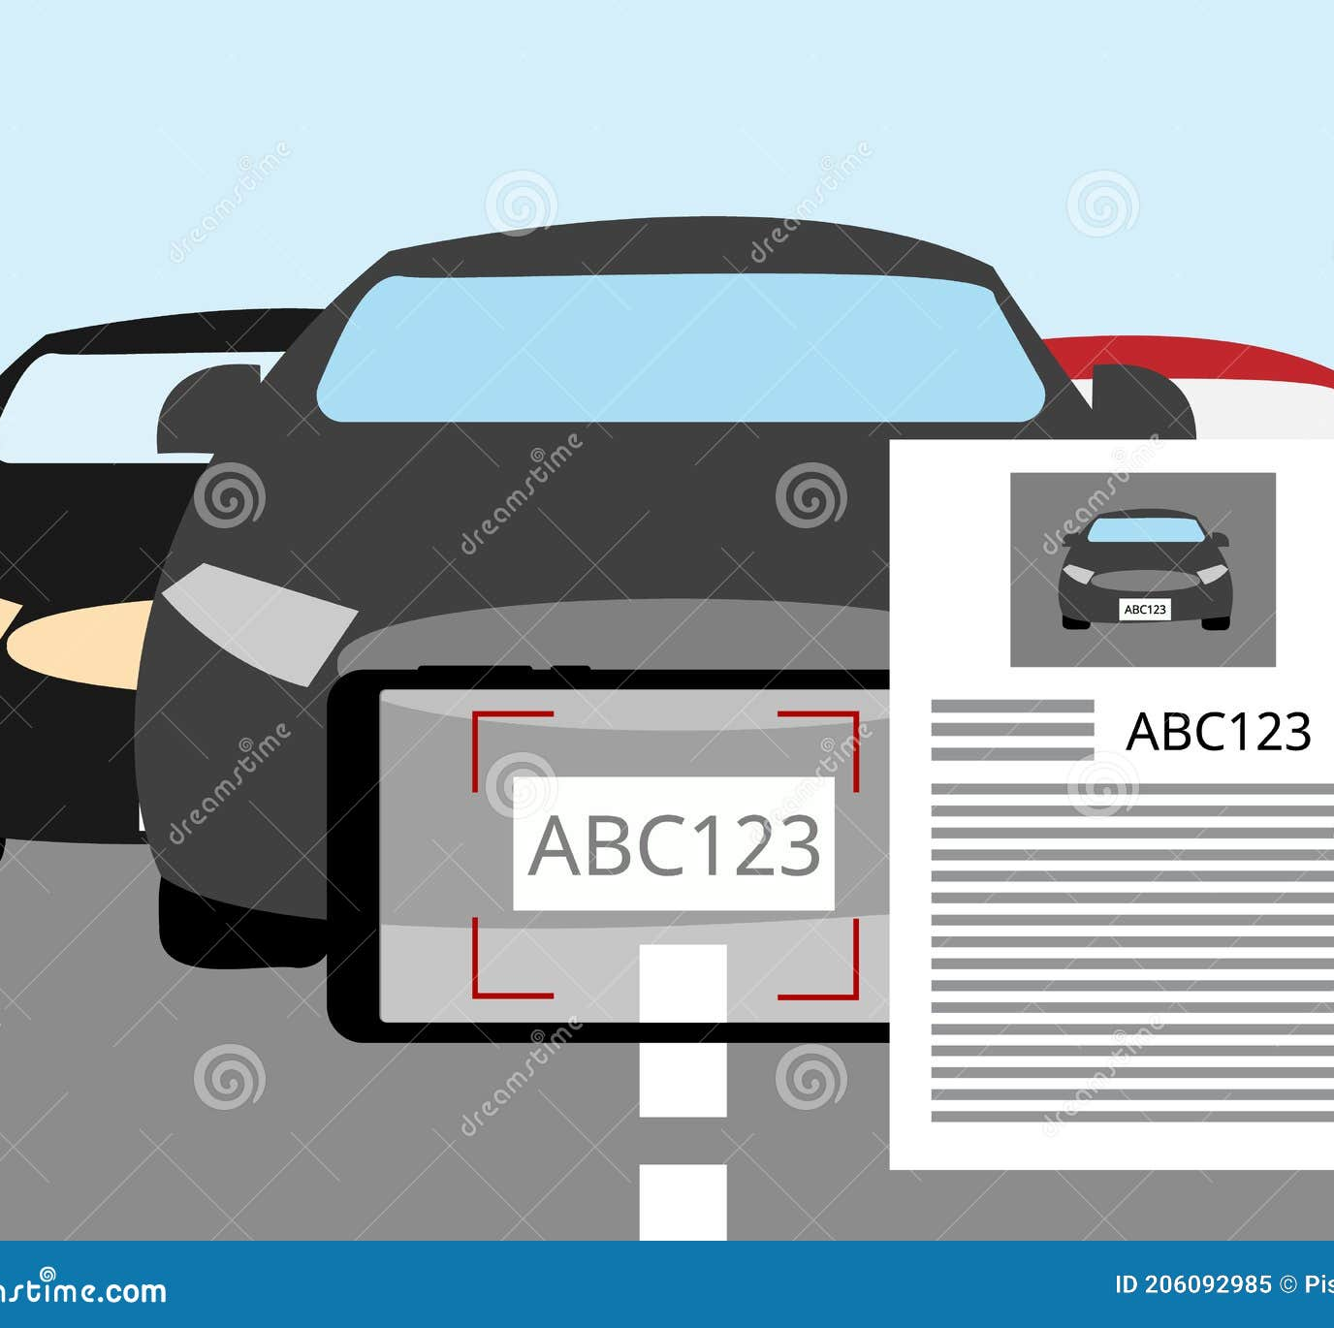
EASYOCR
EasyOCR, as the name suggests is a Python package that allows computer vision developers to effortlessly perform Optical Character Recognition. We used this to detect text from our number plate. It is composed of 3 main components: feature extraction (we are currently using Resnet) and VGG, sequence labeling (LSTM) and decoding (CTC).

Slide 5
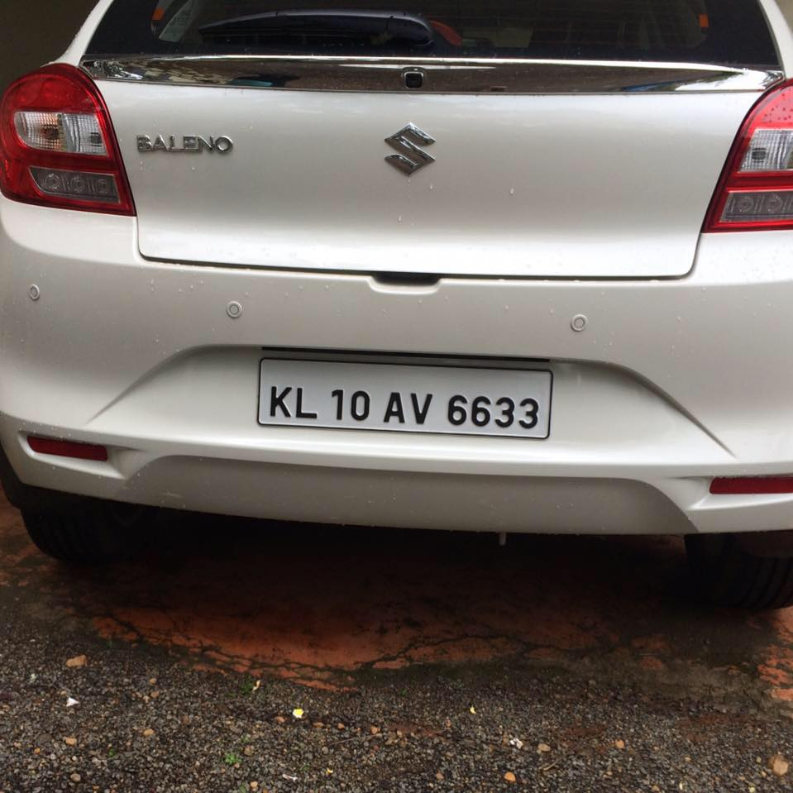
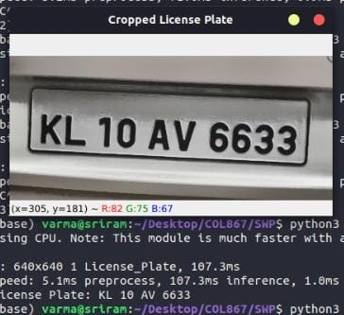
RESULT-1

Slide 6
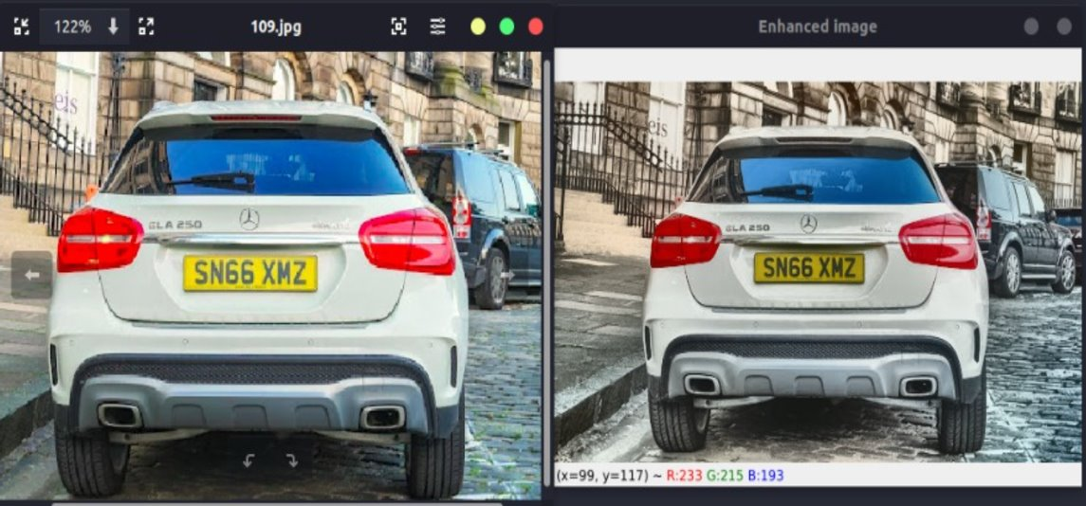
Image Analysis

Slide 7
Image Analysis
We converted our image into LAB space. LAB separates into three channels luminance(L) and color information A and B
Contrast Limited Adaptive Histogram Equalization (CLAHE) to L channel. Thus reducing the contrast of the image
Next we applied Bilateral filter to smoothen this overall image to make text recognition more prominent.

Slide 8
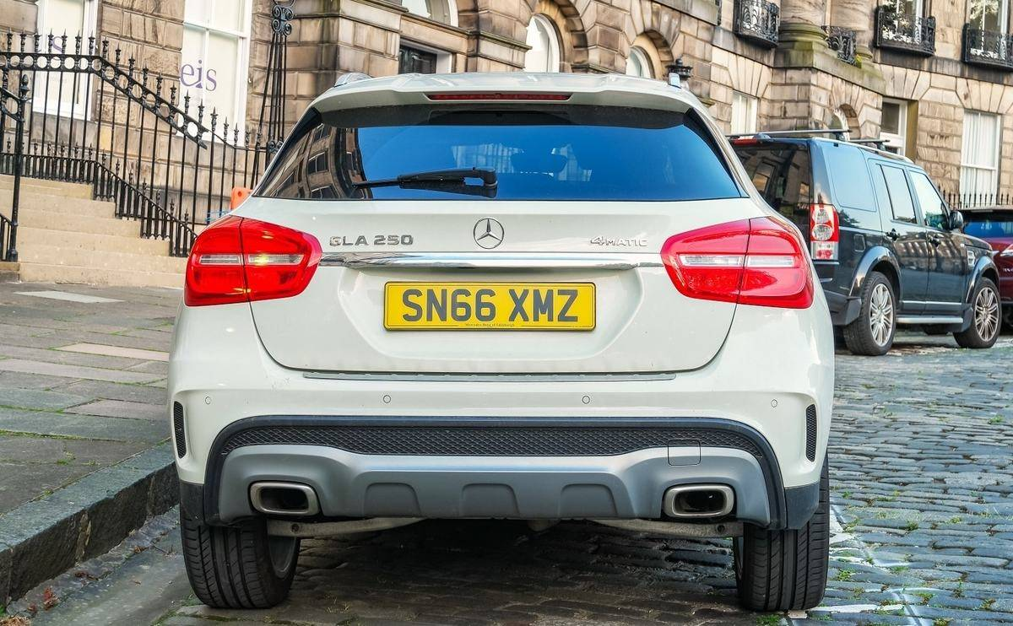
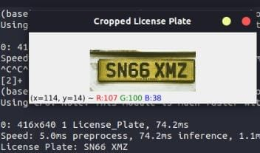
RESULT-2(Supervised)

Slide 9
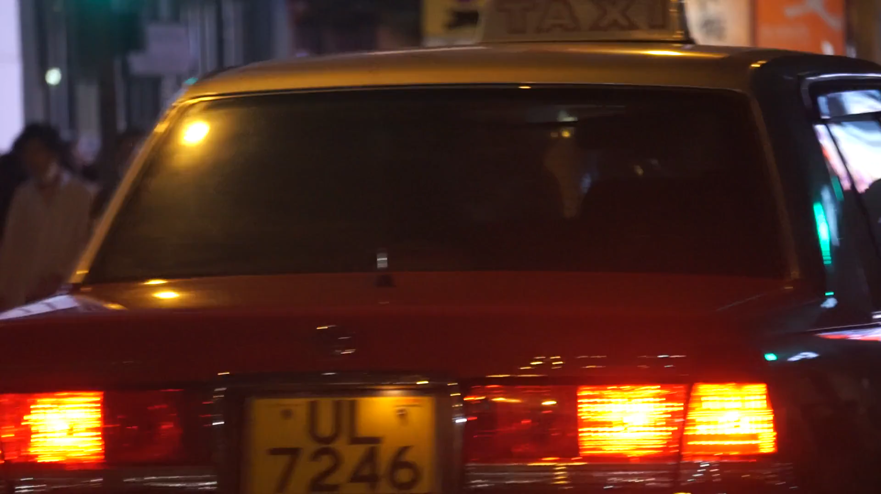

Slide 10
Optimizations
Frame skipping
Batch processing
Threading

Slide 11
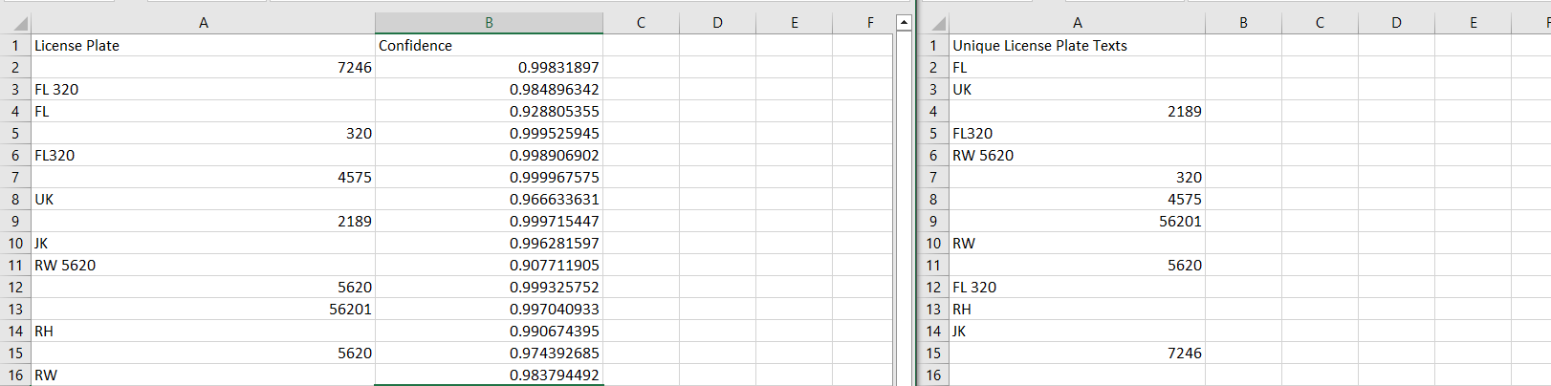
RESULT-3

Slide 12
Future Work/Conclusion
Use case depends on the environment we want use for training the model or when to perform image analysis
Edge computing on network of cctv’s – live streaming data

Slide 13
Thank You!! Doubts?

